Slide 1


OUTCOMES MATTER.
ISM CAN HELP.
ISM®
OVERVIEW
www.instituteforsupplymanagement.org

Slide 2

The ISM mission is simple – We advance the practice of supply management to drive value and competitive advantage, and contribute to a prosperous, sustainable world. We do this through education, industry certification, research and information distribution, including the monthly ISM Report On Business®.
More than 100 years of experience speaks for itself:
ISM can help you succeed.
Notes:
Our ISM mission is simple – we help professionals generate positive outcomes. ISM is there for practitioners at every level in their career.

Slide 3

ISM MEMBERSHIP
Connecting over 50,000 professionals globally
Our network reaches over 130,000 professionals annually

Slide 4


ISM
OUR MEMBERS AROUND THE GLOBE
1,623
Europe
40,1 75
North America
3,863
Asia
1,171
Middle East
321
Africa
1,679
India
1,163
Latin America
169
Oceania
We have 79 Corporate Member Companies and
over 116 affiliates throughout the globe.
4
Notes:
This is a nice representation of where our members are through out the globe.

Slide 5

MEMBER BENEFITS
Career enhancing tools to help you advance

Slide 6












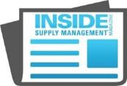

ISM
HIGHLIGHT OF KEY MEMBER BENEFITS
CAREER CENTER | PODCASTS | WEBINARS | TOOLS & TEMPLATES | GLOSSARY
EXTENSIVE NETWORK | RESEARCH | PURCHASING & SUPPLIER GUIDE | PRO PURCHASER | BUSINESS SOURCE
ISM MASTERY MODEL | PUBLICATIONS | GROUPS & FORUMS
and more
6
Notes:
Podcasts – over 120
Tools & Templates – SOW, contract termination (coming soon)
Research – Salary Survey and CAPS Research
ISM Mastery Model – Career Road Map and I’ll talk a little more about that in a few minutes.
Publications – We offer a variety of publications including Inside Supply Management, which I’ll talk more in a minute.

Slide 7
ISM
CONNECTION THROUGH MEMBERSHIP
ISM GROUPS
ISM Groups are composed of members with common interests for education and networking in various topics.
Indirect/Services
Materials Management Group
Northeast Supply Management Group
Supplier Diversity Group
Supplier Management Group
Supply Chain Risk Management Group
Women in Leadership
ISM FORUMS
ISM Forums are composed of members who are employed in a specific sector and come together for the sole purpose of exchanging information and ideas about supply management in that specific sector.
New York/New Jersey Forum
Pharmaceutical Forum
Southwest Forum
Steel Buyers Forum
Utility Purchasing Management Group
7

Slide 8
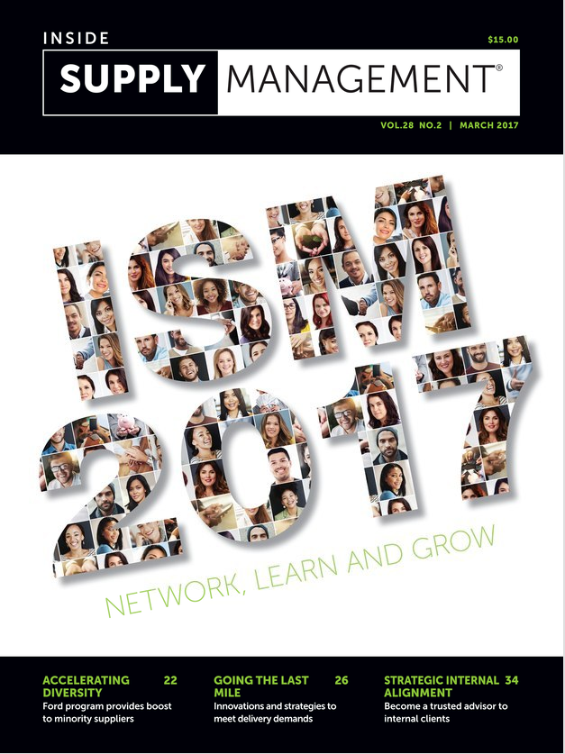
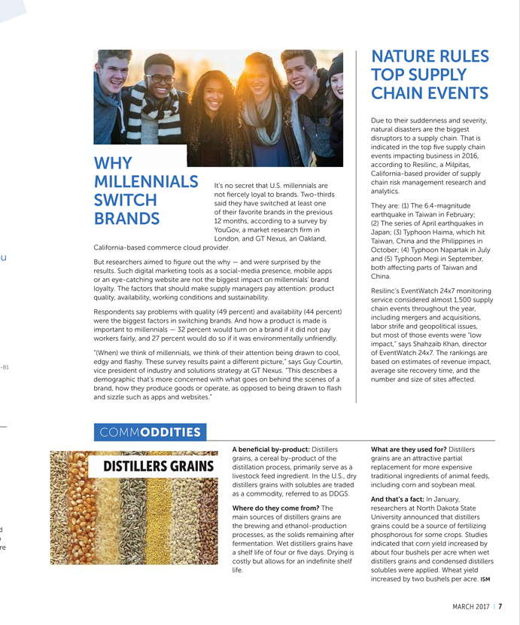
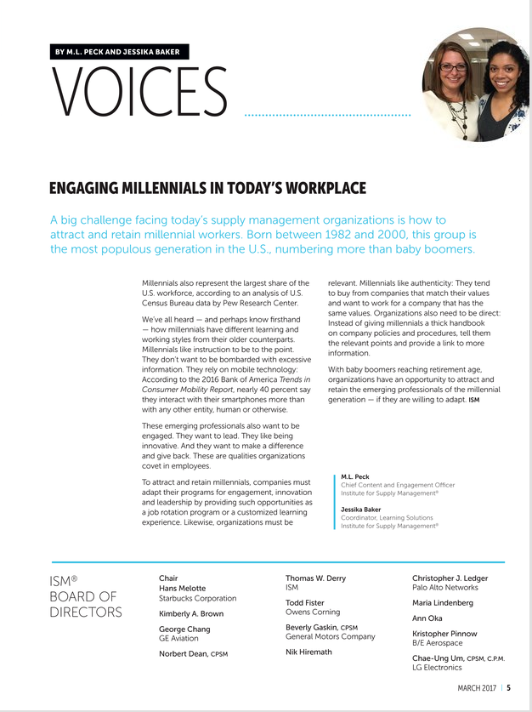
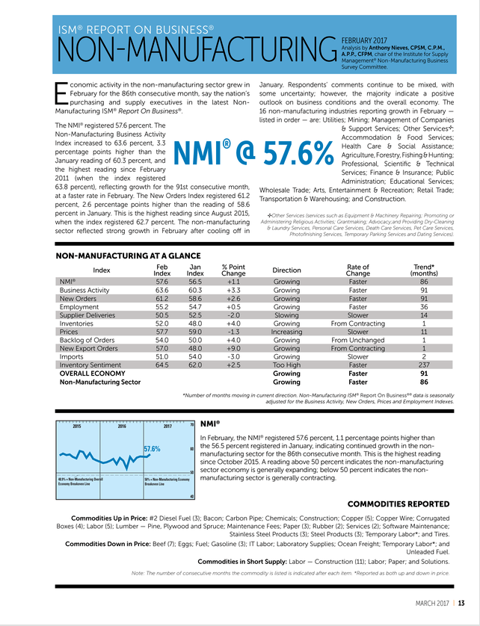
ISM
PUBLICATIONS
PUBLICATION | FREQUENCY
Inside Supply Management® magazine ISM’s monthly members only magazine features the latest industry information and trends that you need to know about. | 9 issues/year
E³: Engage // Elevate // Emerge Our new digital, quarterly newsletter has insightful articles geared toward ISM members who are emerging or established in their field. | Quarterly
ISM Dashboard ISM and CAPS Research brings you a weekly snapshot of the latest research including study findings and benchmarks to keep you current with supply chain management trends. | Weekly
Supply Chain Weekly We know you’re busy, so each week, we scour thousands of news sources for pertinent supply chain news and information. We select only the best and present it to you in this unique, time-saving e-newsletter. | Weekly
8
Notes:
These are just a few of our publications you have access to. If you haven’t already make sure to download the ISM Magazine app where you can access Inside Supply Management Magazine as well as bonus supplements that are released through out the year.
Shortly I will share with you how you can subscribe to these publications via email.

Slide 9

ISM REPORT ON BUSINESS®
ISM publishes two monthly reports, the Manufacturing ISM Report On Business® and the Non-Manufacturing Report On Business®. The ROB is based on a national survey of purchasing managers tracking changes in the manufacturing and non-manufacturing sectors. It is considered to be one of the most reliable economic barometers of the U.S. economy and gives an important early look at the health of the nation’s economy.
Notes:
The ISM Report On Business is highly regarded report as it is an economic indicator.

Slide 10

ISM LEARNING SOLUTIONS
Don’t just succeed in supply management, Master it.
Notes:
We offer a number of development and career enhancing tools.

Slide 11
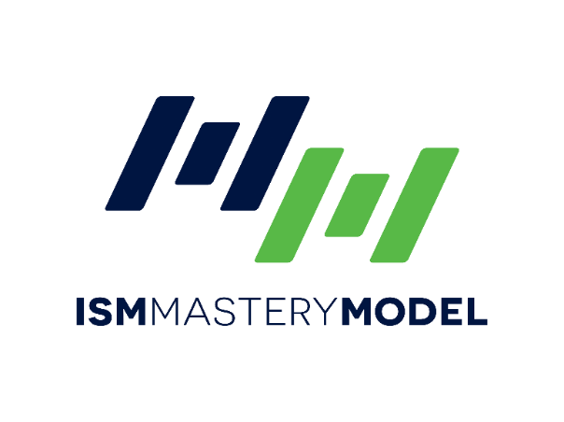

ISM
LEARNING SOLUTIONS
ISM MASTERY MODEL™ is a comprehensive set of competency-based standards of excellence for supply management practitioners worldwide.
ISM MASTERY MODEL ASSESSMENT is a valuable addition to the Mastery Model. It enables individuals to assess their level of skill and ability against an established standard.
Take your career to the next level, visit www.ismmasterymodel.org, to begin your journey.
Notes:
MASTERY MODEL: The purpose of the model is to help your team deepen its expertise, drive your organization’s success and increase your employment profile — putting supply management mastery to work. It is comprised of 16 major competencies and 69 sub-competencies, tailored to four different career levels.
ASSESSMENT: It helps the individual identify where skill gaps may be present and it recommends resources. This valuable assessment also creates a basis for conversation between an individual and management. ​

Slide 12




ISM
LEARNING SOLUTIONS
ISM is constantly striving to create career-enhancing learning solutions to help keep you on top of your game. We have a large selection of solutions, in various formats, to fit your educational needs—and your busy schedule.
NEW! eISM | CONFERENCES | PUBLIC SEMINARS | WEBINARS
12
Notes:
eISM, is a new online learning platform.
Conferences, we have our annual conference which draws over 2,500 practitioners and small conferences throughout the year. Utility Purchasing, Indirect, Diversity and T&E.
Seminars, we offer over 40 seminars in the US.

Slide 13





Visit www.ismeLearning.org
ISM
LEARNING SOLUTIONS
INNOVATIVE eLearning,
developed just for YOU
3 different learning styles
Just in Time 5-15 minutes in length. | Self Paced Create your own schedule with these 1-3 hour courses. | Guided Learning Structured group activities that include due dates, peer interaction on forums, and webinars.
13
Notes:
Reference the Mastery Model assessment and using their results to use it as a guide to select the courses needed to level up their skills.

Slide 14
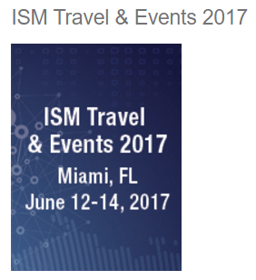
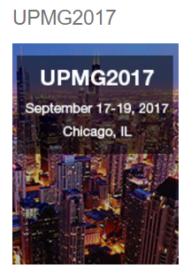
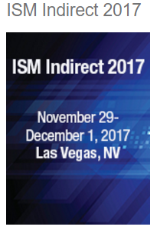

ISM
UPCOMING EVENTS
If you’re now supporting the travel and events category for your organization, we have some great news: The experts at ISM Travel & Events 2017 are here to help.
Recognized as one of the premier educational events within the utility supply chain industry, UPMG2017 will help you go the “Magnificent Mile” to improve your supply chain.
Indirect spend represents a significant impact to the bottom line. Join us and discover how to strengthen your impact by learning practical supply chain strategies and gaining insights from leading experts and industry innovators.
14
Notes:
This infographic highlights the benefits to the organization.

Slide 15

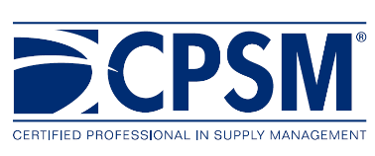
ISM CERTIFICATION
ISM certification is a cornerstone to achieving excellence – the gold standard for training and expertise in the supply management industry. Becoming a Certified Professional in Supply Management® (CPSM®) establishes you as someone who has mastered the core competencies of the foundational aspects of procurement and sourcing, contracts, negotiation and leadership.
Learn more at www.ismcertification.org
Notes:
Obtaining an ISM certification establishes you as someone who has mastered the core competencies in supply management. It is a highly regarded certification and in some organizations it has become a requirement. As an ISM member you have access to the study materials and exams at a discounted price. Learn more at www.ismcertification.org.

Slide 16
ISM
CERTIFIED PROFESSIONAL IN SUPPLY MANAGEMENT
CRITERIA
Pass three Exams Exam 1 – Foundations of Supply Management Contracting and Negotiation, Social Responsibility, Cost and Finance, Sourcing, International Supplier Relationship Management. 165 Questions; 2 hrs 45 minutes Exam 2 – Effective Supply Management Performance Forecasting, Materials and Inventory Management, Logistics, Organization and Department Assessment, Product and Service Development, Quality, Planning. 165 Questions; 2 hrs 45 minutes Exam 3 – Leadership in Supply Management Leadership, Strategic Sourcing, Risk Compliance. 180 Questions; 3 hrs
Document Work Experience Three years full-time professional supply management experience with a regionally accredited bachelor’s degree or international equivalent OR Five years full-time professional supply management experience without a qualified degree.
Submit CPSM® Original Certification Application Applications are accepted online at www.insttituteforsupplymanagement.org – CPSM/CPSD Certification.
Recertify To maintain your certification, you must recertify every three (3) years with 60 Continuing Education Hours (CEHs).
16

Slide 17



ISM
CONTINUING EDUCATION HOURS
Continuing Education Hours (CEHs) are needed to recertify ISM-issued certifications. ISM will accept CEHs related to business, computers, your job, your company, or your product.
At least two-thirds of the CEHs must be educational in nature. One-third may be earned in the professional contributions category.
ONLINE LEARNING | CONFERENCES & SEMINARS | WEBINARS | MAITAIN MEMBERSHIP | WRITING ARTICLES | VOLUNTEERING
17

Slide 18



ISM
HOW THE CPSM® & CPSD™ BENEFITS THE INDIVIDUAL
Be gl☑bally
relevant
MORE PAY!
Earn about
9% more annually

8 10
executives
endorse CPSM
$ affordable &
timely to achieve
out
of
Take your Career to
the next
Level
CPSM is
TRANSPORTABLE
Between manufacturing & nonmanufacturing
18
Notes:
This infographic nicely demonstrates the benefits of obtaining an ISM Certification.

Slide 19


THANK YOU
ISM
309 W. Elliot Road, Suite 113 Tempe, AZ 85284-1556
membersvcs@instituteforsupplymanagement.org

